Slide 1

Forecasting Food Service Shipment Demand Case Study Time Series Analysis and Forecasting for Shipment Data
MARCH 15, 2019
Presented By:
Annie Phan | Andrew J. Luong | Venku Buragadda
Audience:
MSCA 31006 Time Series Analysis

Slide 2
Accurate Forecasting of Food Service Demand Enable better Service Level and Resource allocation
Motivation
Assumptions/Description
Model Selection
Model Evaluation
Model Validation
Conclusion
Context and Background:
Critical metric in the food service industry is the service level at the restaurant level (e.g. do shipments of cases arrive on time and in the right quantity)
In order to achieve high levels of service and staff logistics team appropriately, companies often turn to forecasting on a daily level to account for the ever-changing demand
Business Problem:
Food service restaurants struggle with predicting the correct demand due to a variety of complexities such as limited time offerings, promotional seasons, changing customer demand, and external weather effects
We are provided a year of daily shipment data and the goal is identify the appropriate time series model to best model all year long shipment demand on a daily basis
Time Series Analysis Application:
Times series analysis will allow us to 1) characterize the current shipment behavior and also 2) predict future shipment demand

Slide 3
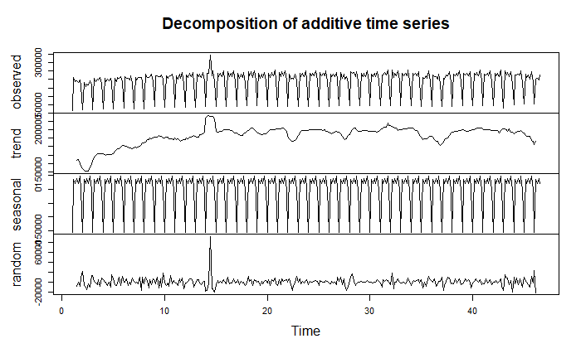
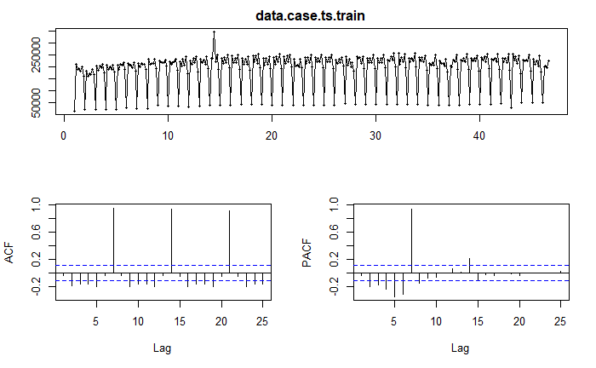
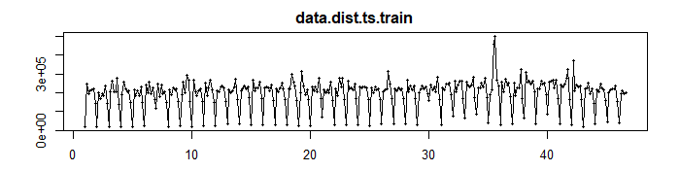
Our preliminary Exploratory of Shipment Narrows down the model Selection
Motivation
Assumptions/Description
Model Selection
Model Evaluation
Model Validation
Conclusion
Descriptive Analysis & Assumptions :
Trend: Stationary Validated
KPSS (p = 0.01)
ADF Testing (p = 0.61)
Seasonality:
Detectable seasonality in a seven day interval (weekly)
Cyclical Behavior:
None detected in the shipment data
Univariate Predictor:
Daily Total Distance traveled should be positively correlate with more trips = more cases, one can see pattern reflected in time series display of both case and distance

Slide 4
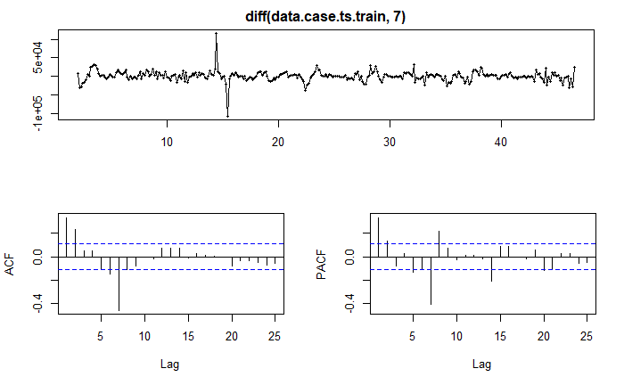
Our preliminary Exploratory of Shipment Highlights Likely AR and sMA order
Motivation
Assumptions/Description
Model Selection
Model Evaluation
Model Validation
Conclusion
ACF and PACF indicates the presence of a non-zero AR order and sMA order
First order differencing with lag of 7 is further strengthen with the associated ACF and PACF view.

Slide 5
Build time series model based on Exponential Smoothing, sARIMA and Regression with Arima Errors
Motivation
Assumptions/Description
Model Selection
Model Evaluation
Model Validation
Conclusion
Due to the lack of large amounts of regressors, we ultimately settled on the three most practical model types, exponential smoothing, seasonal ARIMA models and Regression with ARIMA errors
We will use a training and holdout data set to execute a first pass on model evaluation for each of the models
Exponential Smoothing
SARIMA
Regression with ARIMA Errors
Model Rationale:
Easy to Execute
Provide a basis to compare the other models to a smoothing function
Model Rationale:
Detectable seasonality, clear AR and sMA order in the ACF/PACF model
Intuition suggest AR model will be key to a periodic operations
Model Rationale:
Univariate relationship between cases and distance
Model should predict the cases better with the addition of distance data, then allow errors to be handled with ARIMA

Slide 6
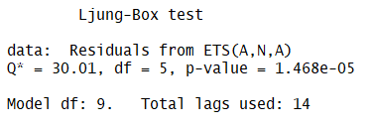
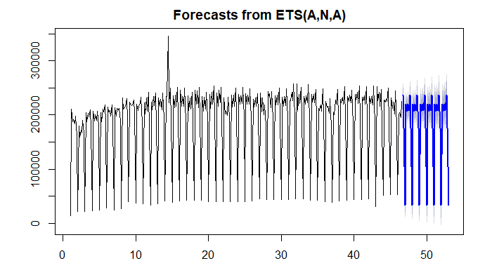
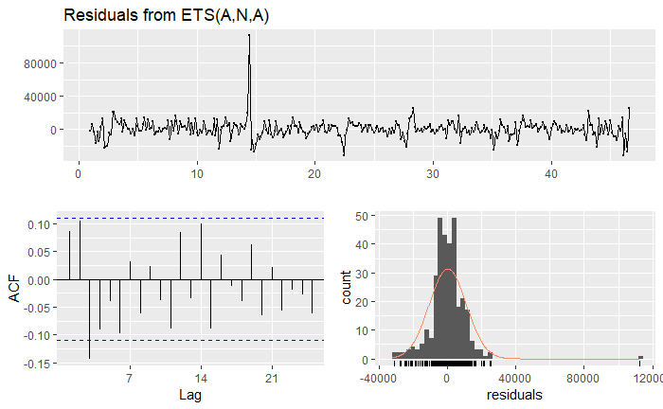
Building Model for Exponential Smoothing
Motivation
Assumptions/Description
Model Selection
Model Evaluation
Model Validation
Conclusion
For our data have (A, N, A) - Additive Seasonality with level(alpha) and seasonal(gamma) smoothing parameters.
Note that smoothing parameters: alpha = 0.2236 gamma = 0.0903
p-value < 0.05; thus residuals are not completely independent

Slide 7
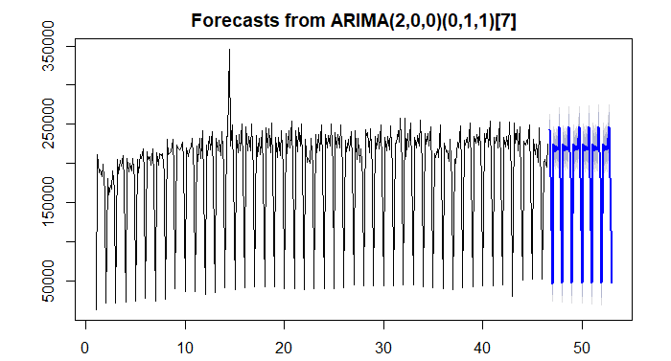
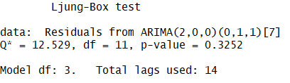
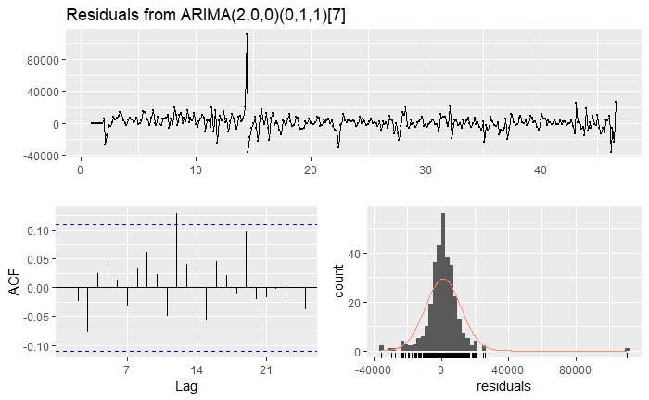

Building Model for SARIMA
Motivation
Assumptions/Description
Model Selection
Model Evaluation
Model Validation
Conclusion
For our data we have Non-seasonality (p,d,q) as (2,0,0) and Seasonality (P,D,Q) as (0,1,1) with 7 day seasonality.
Significant AR and sMA coefficients for the model
p-value >> 0.05; thus residuals are independent

Slide 8
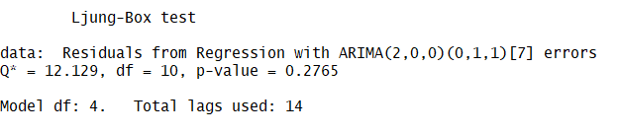
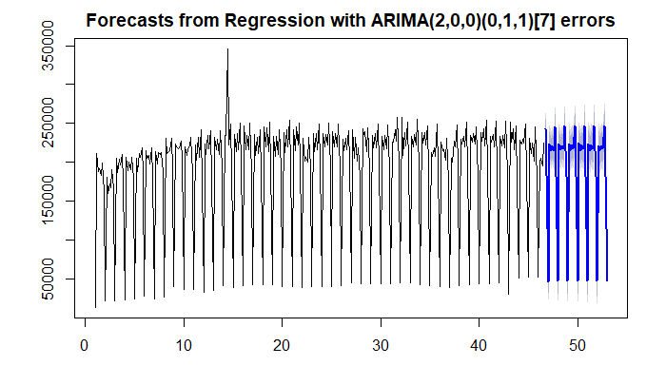
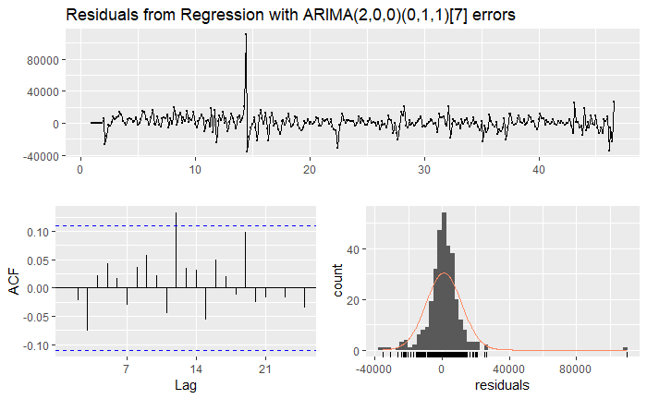
Building Model for Regression with Arima Errors
Motivation
Assumptions/Description
Model Selection
Model Evaluation
Model Validation
Conclusion
For our data Regression with ARIMA error shows similar order but different AICc and lower MAPE, MAE and RMSE (See Next Slide)
p-value >> 0.05; thus residuals are independent

Slide 9
Evaluation of each model AICC, MAPE and MSE Reveals a candidate model for shipment data forecasting
Motivation
Assumptions/Description
Model Selection
Model Evaluation
Model Validation
Conclusion
Likely Best Models
Model Performance Evaluation | Exponential Smoothing | SARIMA | Regression with ARIMA Errors
AICc | 7812.57 | 6710.99 | 6712.28
Training MAPE | 4.88 | 4.06 | 4.06
Holdout MAPE | 24.66 | 24.38 | 23.99
Training RMSE | 10835 | 10601 | 10588
Holdout RMSE | 39308 | 41137 | 40504
Train and Holdout with accuracy analysis shows that either SARIMA or Regression with Arima Errors are good models to evaluate current and precited values; however we will use cross-validation to test which is the better model. Note that in the Regression with Arima Error the models are more stable from training to holdout

Slide 10
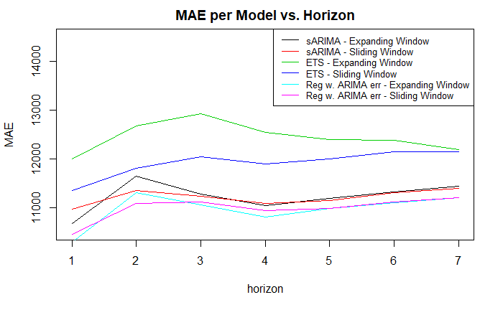
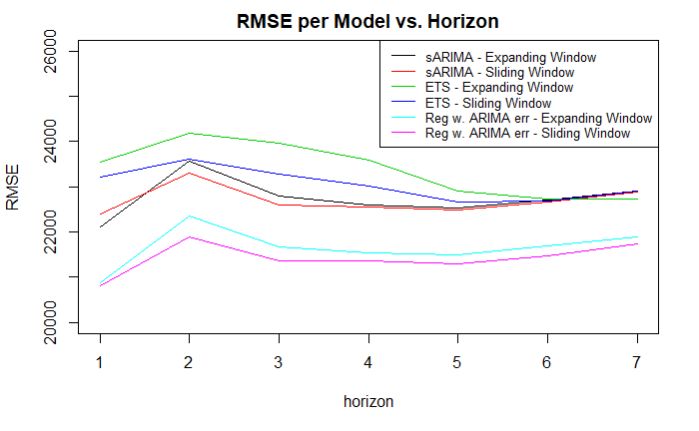
Cross Validation also us to refine the better model and affirms our initial hypothesis
Motivation
Assumptions/Description
Model Selection
Model Evaluation
Model Validation
Conclusion
Both in the MAE and RMSE, it shows the Regression with Arima Error outperforming both ETS and sARIMA with the lowest MAE and RMSE for all 7 horizon

Slide 11
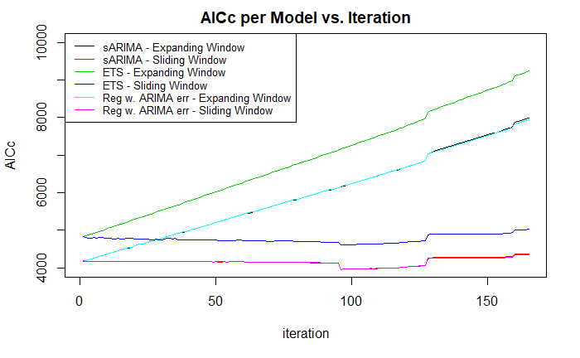
AICc Testing allows us to determine both ARIMA models are better than ETS in prediction
Motivation
Assumptions/Description
Model Selection
Model Evaluation
Model Validation
Conclusion
With both the sARIMA and Regression with ARIMA error overlapping each other, there is no real difference between the two models from a complexity standpoint. The Regression with Arima Error is slightly more complex given the regression, but that complexity penalty is negligible.

Slide 12
Choosing SARIMA as a Model FORECAST ALLOW us to best forecast shipment on a daily basis
Motivation
Assumptions/Description
Model Selection
Model Evaluation
Model Validation
Conclusion
[Results] - Model Summary:
Chosen Model: Regression with Arima Error given similar AICc but lower MAE, RMSE than sARIMA model; thus, the preferred method
From a business perspective, sARIMA model would still be viable and might be preferred since it requires less data on total route distance on a daily basis.
[Future Work] - Improving Forecasting Ability:
Huge potential for regression model on different predicators that may be better indicators for shipment data such as restaurant traffic data (common sense would dictate a better predicator to show demand)
Could benefit with increased time range into 2 years to show the seasonality of the months as well that could impact the forecast

Slide 13
Appendix
Supply Chain Shipment Forecasting Case Study

Slide 14
Case Study Final Project Roles and Responsibility
Task | Annie Phan | Andrew Luong | Venku Buragadda
Topic Selection | X | X | X
Data Cleaning and Prep |  | X
Data Validation | X |  | X
ETS Modeling* | X |  | X
ETS Validation |  | X
sARIMA Modeling* | X | X
sARIMA Validation |  |  | X
Reg with Arima Error Modeling* |  | X | X
Reg with Arima Error Validation | X
Cross Validation | X | X
Deck Template Layout |  | X
Analysis and Commentary | X | X | X
R Markdown Compile | X | X | X
*Please note that in modeling and validation, we took an approach to have two of three model with the last one as an external validation

